Slide 1
CS 2600 Computer Networks I Dr. Sayeed Sajal Lecture 11 Modulation and Modems

Slide 2
“Modulation” vs. “Shift Keying”
When we transmit analog information (like audio or traditional TV) over an analog transmission system, we call that process modulation
For example, an FM radio transmitter performs frequency modulation to transmit analog voice and music. An FM receiver performs demodulation to recover the analog audio signal
To distinguish that from the process of transmitting digital computer data (bits) over an analog transmission systems, the alternate term shift keying is sometimes used
For example, the old 56Kbps V.90 modems used phase shift keying
Unfortunately, the industry is inconsistent about these terms. It is still common to call the transmission of digital data over analog “modulation”
For example, one of the current systems for transmitting digital data over an analog transmission system is called QAM (Quadrature Amplitude Modulation)

Slide 3
Analog Carrier Signal
amplitude
time

Slide 4
Amplitude Shift Keying

Slide 5
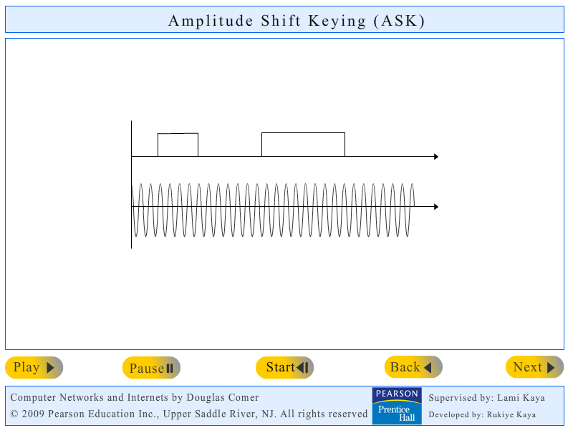
Doug Comer’s Amplitude Shift Keying Demo*
*Click the image to link to the simulation website
http://www.netbook.cs.purdue.edu/animations/Amplitude Shift Keying.html

Slide 6
Frequency Shift Keying

Slide 7
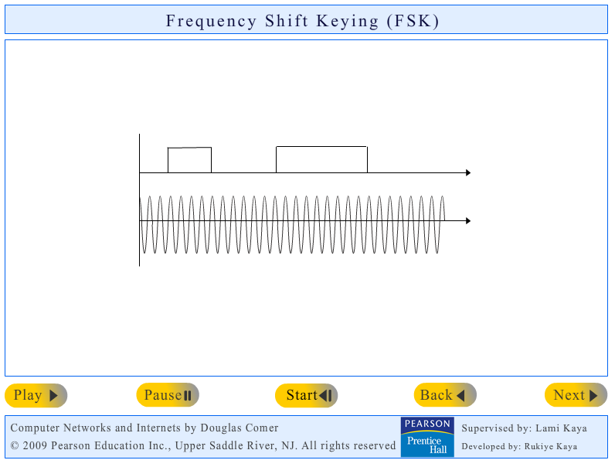
Doug Comer’s Frequency Shift Keying Demo*
*Click the image to link to the simulation website
http://www.netbook.cs.purdue.edu/animations/Frequency Shift Keying.html

Slide 8
Effect of Phase Shift on a Signal

Slide 9
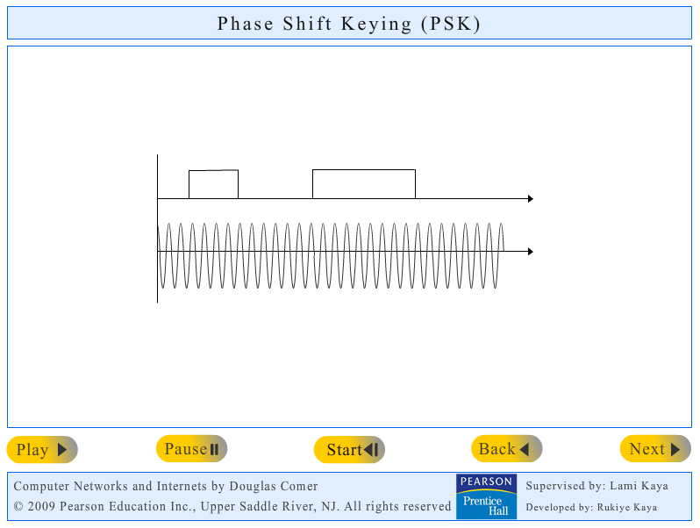
Doug Comer’s Phase Shift Keying Demo*
*Click the image to link to the simulation website
http://www.netbook.cs.purdue.edu/animations/Phase Shift Keying.html

Slide 10
Quadrature Amplitude Modulation (QAM)

Slide 11
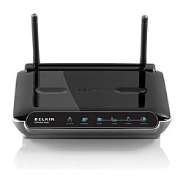
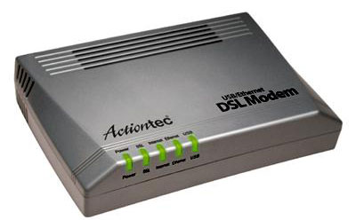
Digital Subscriber Line (DSL) Modems

Slide 12
Digital Subscriber Line (DSL) Configuration
DSLAM*
Local Phone Carrier Switch (Central Office)
*Digital Subscriber Line Access Multiplexor

Slide 13
Digital Subscriber Line Characteristics
Runs on a single copper pair over existing analog phone network local loop
Provides a “hard-wired” virtual circuit to one destination (usually the ISP)
Asymmetric DSL (ADSL) is the most widely used standard
Performance depends heavily on length and quality of local loop
CenturyLink DSL service is capable of 30Mbps downstream
Maximum supported local loop distance is normally 18,000 ft.
Communication between the customer’s DSL modem and the DSLAM may use PPP over ATM cells (PPPoA) or Ethernet frames (PPPoE)
(continued on next slide)

Slide 14
Digital Subscriber Line Characteristics (cont.)
Discrete Multitone (DMT) is most common modulation technology
Uses QAM with up to 255 4.3KHz carrier bands (ANSI std T1.413)
Carrierless Amplitude & Phase Modulation (CAP) is an competing standard that’s on its way out
Requires compatible DSL modem technology at the phone switch (DSLAM), so what you use will depend on your telco
The local CenturyLink service currently offers the Accton® combined modem/router/switch/wireless access point, which uses DMT
Must pay ISP fee in addition to DSL service fee, various ISPs available
The same phone line carries analog voice, and a microfilter is required to prevent the voice from interfering with the DSL traffic, and visa versa
Other xDSL technologies are available, mostly for business use
32 million subscribers in U.S. (as of January 2010)
Also popular in Europe and Asia (roughly 500 million worldwide)

